Slide 1
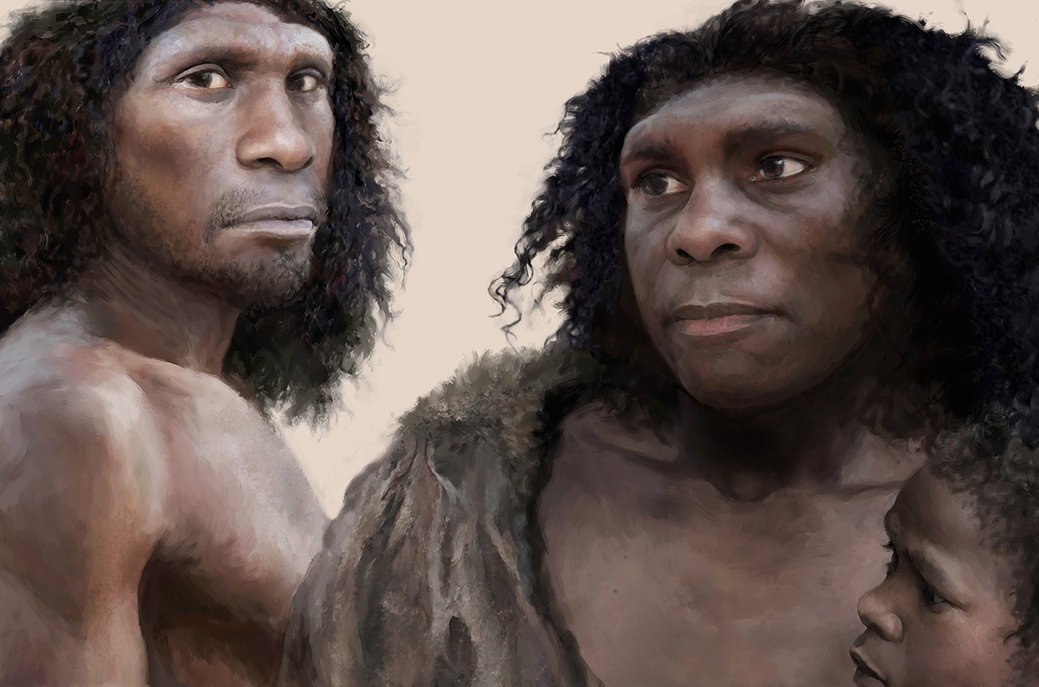
Introgression with Neanderthals
Depression
There are many case of alleles inherited from Neanderthals combining with environmental factors to exhibit negative phenotypic outcomes such as depression. Neanderthal genes involved in controlling circadian rhythms combine with sunlight (or lack thereof) to cause increased likelihood of depression (2.03%).
Heart Disease
It was discovered from a phenome-wide association study that single nucleotide polymorphisms in regions of Neanderthal DNA were associated with a statistically significant increased risk of heritable coronary atherosclerosis as well as 1.39% increase of myocardial infarction (heart attack).
Koller, D. et al. (2022) ‘Denisovan and Neanderthal archaic introgression differentially impacted the genetics of complex traits in modern populations’, BMC Biology, 20(1). doi:10.1186/s12915-022-01449-2.
The interbreeding between Anatomically Modern Humans dispersing from Africa and Neanderthals established in Europe is well documented. There are however, few are aware of the long-lasting genetic impact of this introgression on modern health in non-African modern populations.
Corona Virus
In 2020 an article was published linking a gene cluster inherited from Neanderthals as a risk factor in respiratory failure following contraction of COVID-19 and is carried by about 50% of South Asians and 16% of Europeans.
Zeberg, H. and Pääbo, S. (2020) ‘The major genetic risk factor for severe COVID-19 is inherited from neanderthals’, Nature, 587(7835), pp. 610–612. doi:10.1038/s41586-020-2818-3.
Tom Björklund / Science

